Slide 1


Smart Phone based Tocodynamometer
Biomedical Engineering at Chung Yuan Christian University
Notes:
行動版子宮收縮測量器

Slide 2
Group Memebers & Project Positioning
Members Basic Information
Group Leader: Yi Hsieh (Cary)
Formatting research documents, Pointing sectional assignments, Coordinating technical developments from each part, & SDK Developing (User Interface Display )
Member: Yu-Chun Wang
Scientific Journal Research, Coding with App Inventor, & IPMC signals acquiring
Member: Hsiang-Chun Liao
Scientific Journal Research & Microprocessor Development
Member: Tsung- Ying Lee
Scientific Journal Research, Referencing data collection, & Circuit Design
Assistance of Apprenticeship: pending
Meeting Recording & Documentary

Slide 3
Goals
Due: May 18th, 2015
The goal of this project is to use a smart phone with a built-in accelerometer and a software application to act as a toco transducer and recording tocodynamometer. The device would be used to record the duration of uterine contractions and the duration between them.
-From EWH Projects that Matter
Biomedical Engineering at Chung Yuan Christian University | Engineering World Health

Slide 4
Project Definition
Meeting the requirement in developing world
Limitation: The essentialness of Tocodynamometer is low and has no point to be established without fetal heart rate detector, which normal fetal monitor does. Low profit in the environment in Taiwan.
Advantage: It is convenient and useful for the rural area where hospital and living place are far from each other. Suitable design for third world countries.
- 許文良婦產科<徐樂行醫師>

Slide 5

Agenda
Date of Modification : 5th Jan, 2015
1
Theory of Unterine Activity
2
Introduction to Tocodynamometer
3
Our Approach for this Project
4
Difficulty and Solutions
5
Expecting Works for Next Semester
6
Source of Reference
Biomedical Engineering at Chung Yuan Christian University | Engineering World Health

Slide 6
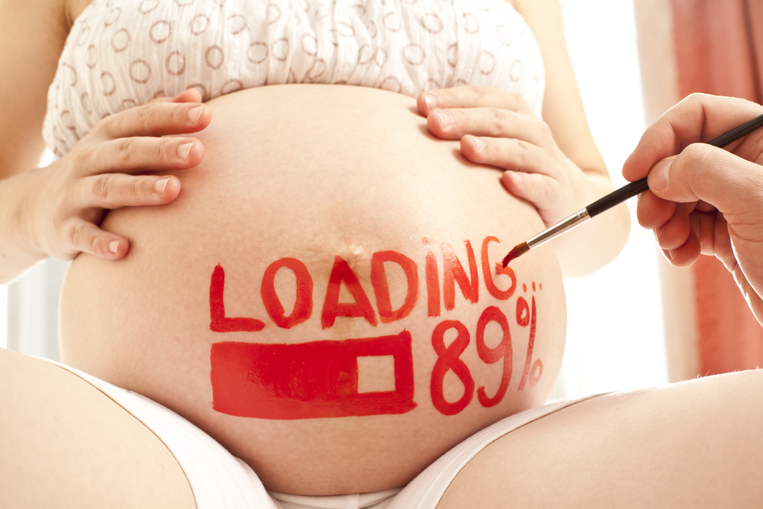
Theory of Unterine Activity
Figure extracted from Discover Magazine, Healthy Pregnancy

Slide 7
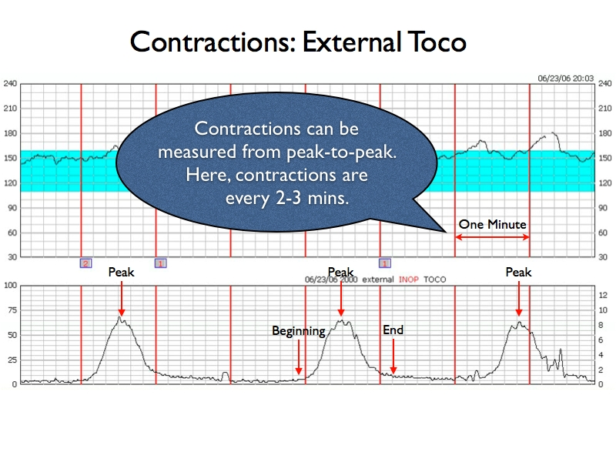
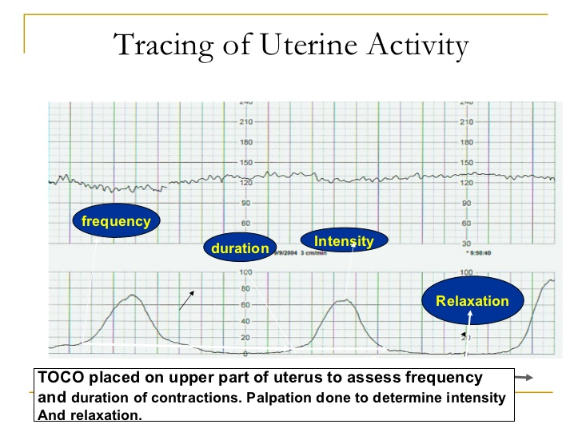
Two types of information can be ascertained from uterine contraction monitoring:
Quantization of uterine activity (the strength of contractions)
Contraction patterns (e.g. how many contractions, how often they are occurring).
Figure Extracted from Sandy Warner RNC-OB, MSN
- Figure Extracted from Center for Experiential Learning, Uterine Contraction
Biomedical Engineering at Chung Yuan Christian University | Engineering World Health
Notes:
子宮收縮測量器會顯示的兩種資訊:
收縮頻率
收縮的樣態

Slide 8
Electronic Assessment of Uterine Contractions
Electronic assessment monitoring of Contractions is done with:
Tocodynamometer when placed on upper portion of uterus frequency and duration of contractions can be determined
Intrauterine pressure catheter (IUPC) catheter placed in uterus measures pressures in the uterus before during and after contraction is over in mmHg. Palpation between contractions still necessary.

Slide 9
Timing Contractions: Frequency, Duration & Intensity
To assess (time) frequency of UC
beginning of one contraction until beginning of next contraction
To assess duration
from beginning of contraction until end of contraction
To assess intensity
palpate fundus of uterus to determine firmness of contraction

Slide 10

Timing Contractions: Uterine Resting Tone
To assess relaxation
Palpate fundus of uterus (between UC). Uterus should be very relaxed (soft). If not soft, then not relaxed. Between UC is when fetus gets blood through spiral arteries of uterus. Resting tone palpation needs to be done with either external or internal UC monitoring

Slide 11
Assessment – Uterine Contractions by Palpation
Contraction
Intensity
Mild
Moderate
Strong
Corresponds to Palpation of
Body Part
Tip of nose
Chin
Forehead
Place hand on fundus of uterus to assess uterine contractions. Keep hand on fundus throughout
several contractions to determine difference between relaxation and contraction increasing
in intensity to peak and then decreasing in intensity to relaxation. Use key above.

Slide 12
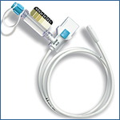
Intrauterine Pressure Catheter
Requires ROM
Pressure of contractions measured in mm Hg
Provides measurement of strength of UC
Notation must be made of resting tone (should be below 20 mm Hg)
Can be re-zeroed if baseline increases
More accurate due to direct measurement of intrauterine pressure

Slide 13

Terminology for Describing Uterine Activity
Normal
Hypotonus and Hypertonus
Multiphasic – dysfunctional
Tachysystole

Slide 14
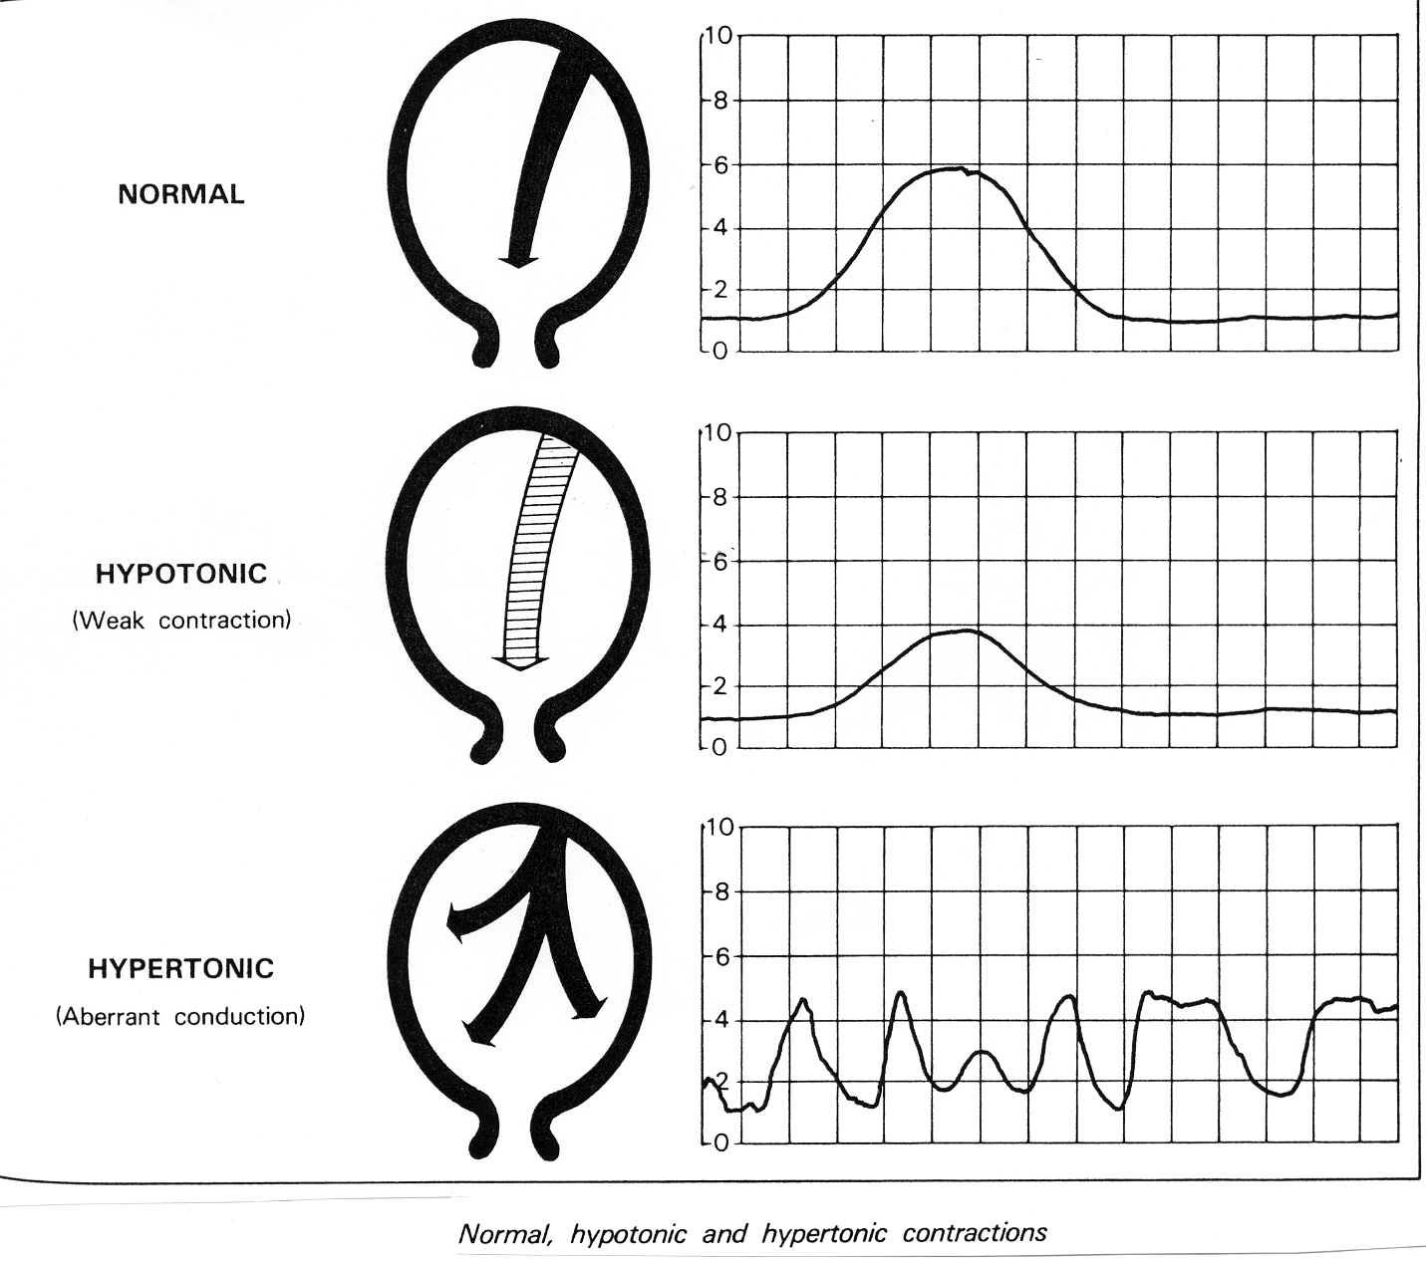
Normal, Hypotonic & Hypertonic Contractions
Bell shaped
Weak contraction
Uncoordinated contraction pattern

Slide 15
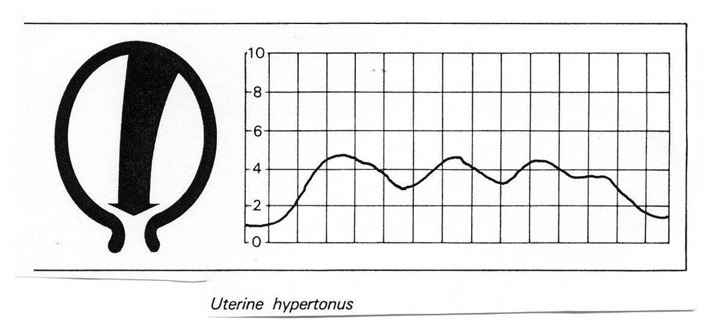
Uterine Hypertonus
Hypertonus - insufficient relaxation between contractions.
Uterus not soft between contractions
If IUPC in place pressure between UC is ≤ 20-25 mmHg.

Slide 16
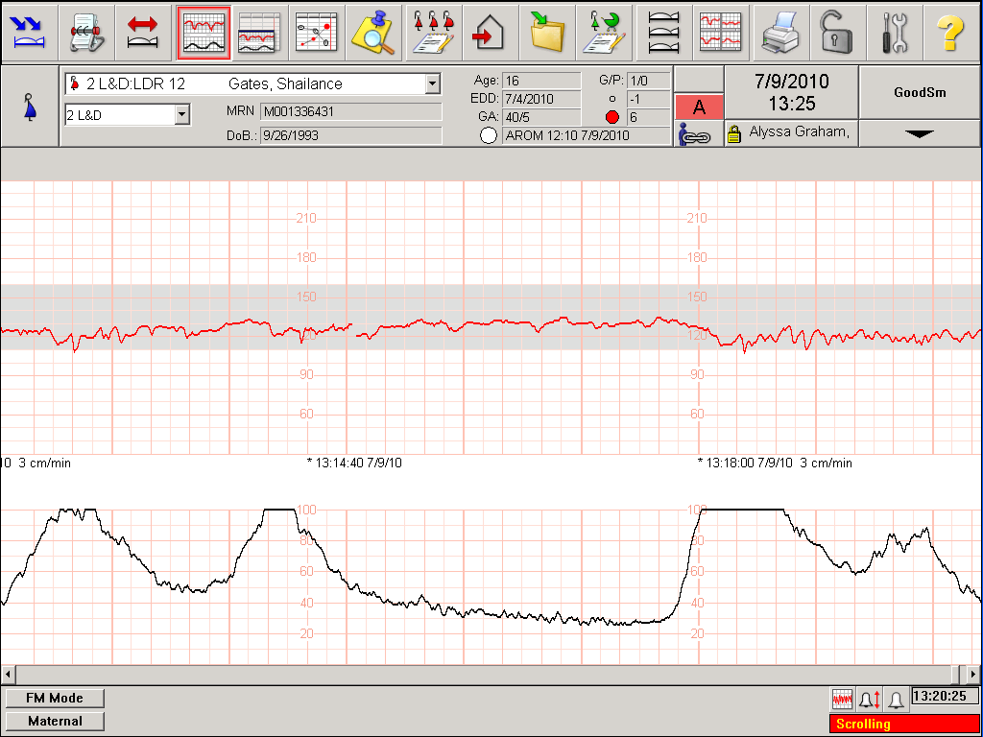
Multiphasic Contractions – (coupling or tripling) - may be caused by over saturation of uterine oxytocin receptor sites
Notes:
Decreasing or stopping pitocin and IV fluid bolus will correct

Slide 17
Tachysystole
> 5 in 10 minutes contractions averaged over a 30 minute window
Always in relation to the presence or absence of decelerations.
Applies to both spontaneous or stimulated labor
Interventions MUST be performed AND documented
Appropriate management of pitocin is essential

Slide 18
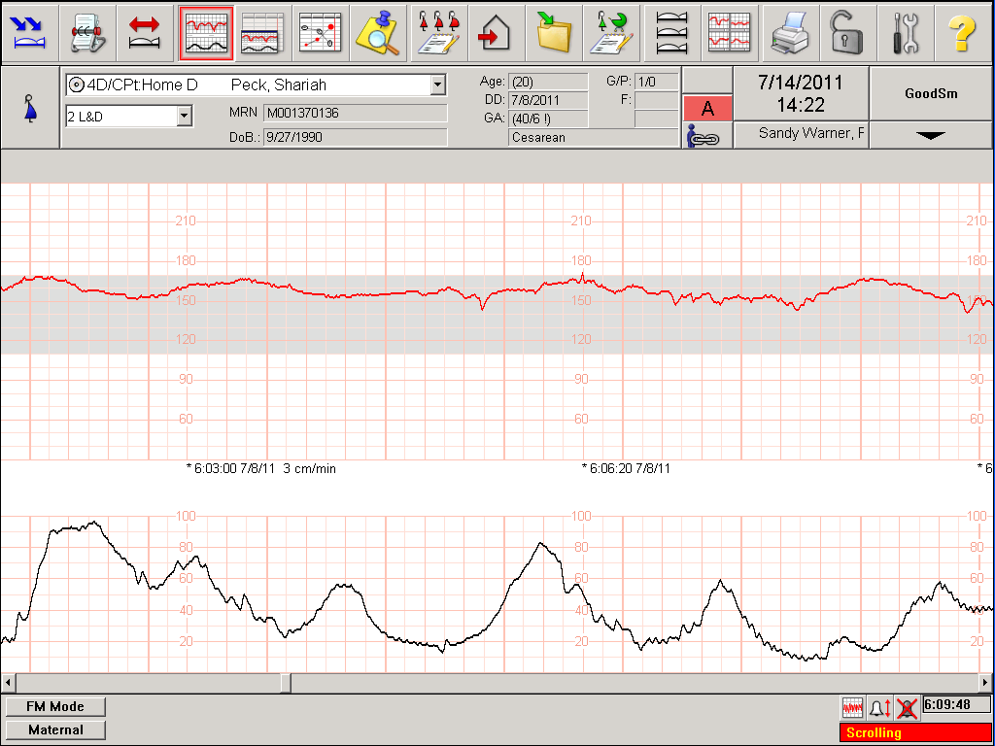
Tachysystole

Slide 20
康琳醫師指出：「懷孕週數和宮縮種類，才是判別孕媽咪及胎兒是否有危險的二大重要依據。」 --- 成大醫院婦產部主治醫師康琳 2008 《媽媽寶寶雜誌》
類別比一比 | ＊假性宮縮 | ＊早產宮縮
收縮頻率 | 不規則 | 規則
收縮強度 | 會變弱 | 會漸強
收縮間隔 | 會自行拉長，消失 | 會越來越短
痛的位置 | 局限下腹部 | 整個子宮（連腰、背也痠痛）
子宮頸變化 | 不會有變化 | 會擴張（頸口變薄變軟）
媽媽的感覺 | 休息會改善 | 持續痛覺（休息也不會好）
宮縮的頻率若規則，且每5～8分鐘就發生乙次，每次持續1～2分鐘，此情形若孕婦已經懷孕達37週，則可能是產兆（真性陣痛），需到醫院評估是否需入院待產；若未達37週，則可能早產（早產宮縮），應盡速就醫，因為可能需要安胎。
Biomedical Engineering at Chung Yuan Christian University | Engineering World Health

Slide 21
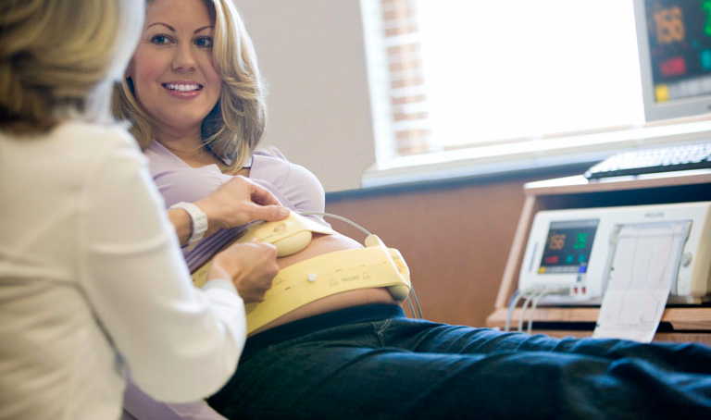
Introduction to Tocodynamometer
-Figure extracted from Philips Avalon Fetal Monitor

Slide 22
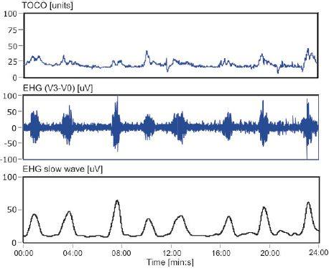
Electrohysterogram & Tocography (1/3)
Tocodynamometer Mechanism
Reference: ADAM MATONIA, KRZYSZTOF HOROBA, et al, 2006, Monitoring Contraction Activity of Uterine Muscle
Tocography
1
For measuring intra-amniotic pressure through the abdominal wall of obstetric patient
Electrohysterogram
2
It is an electrodiagram which is based on recording electrical uterine activity
Figure 1. Waveform Comparison
The contractions curve obtained from EHG signal (V3-V0) and Toco signal
3
Biomedical Engineering at Chung Yuan Christian University | Engineering World Health

Slide 23
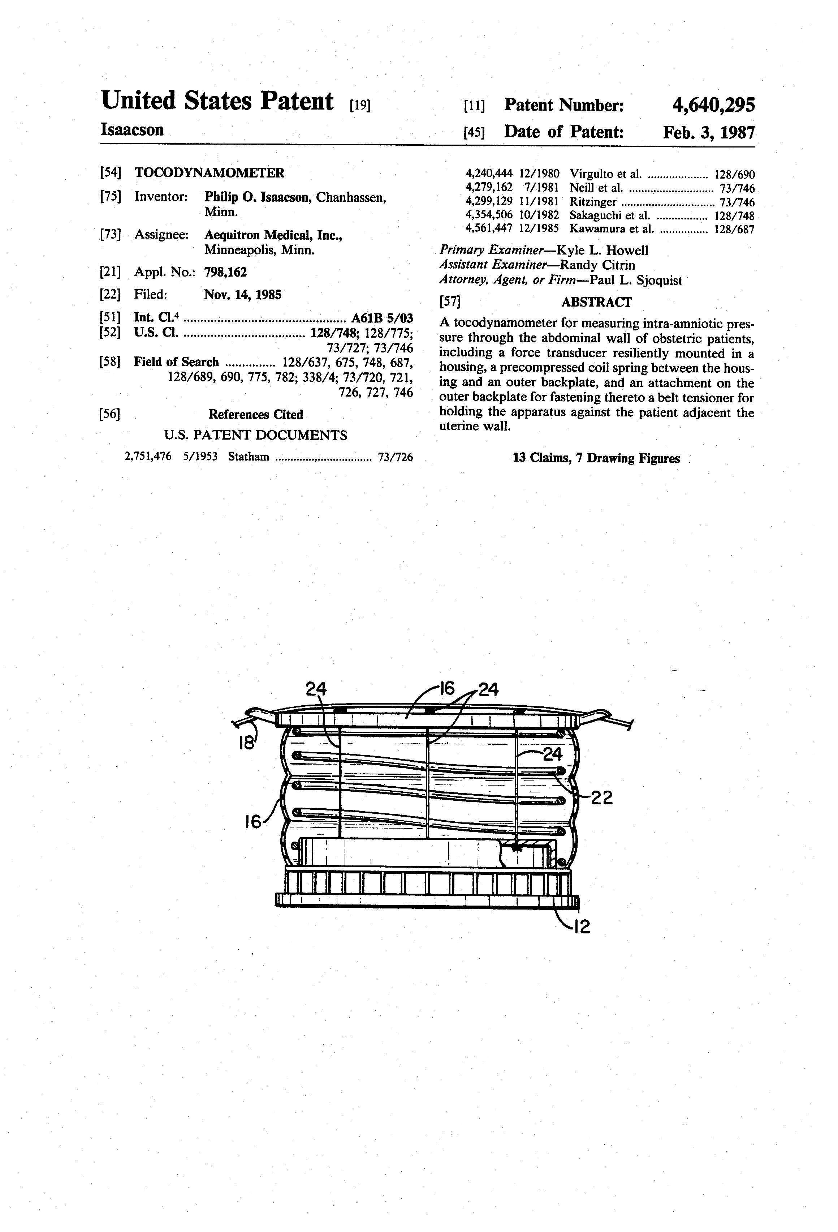
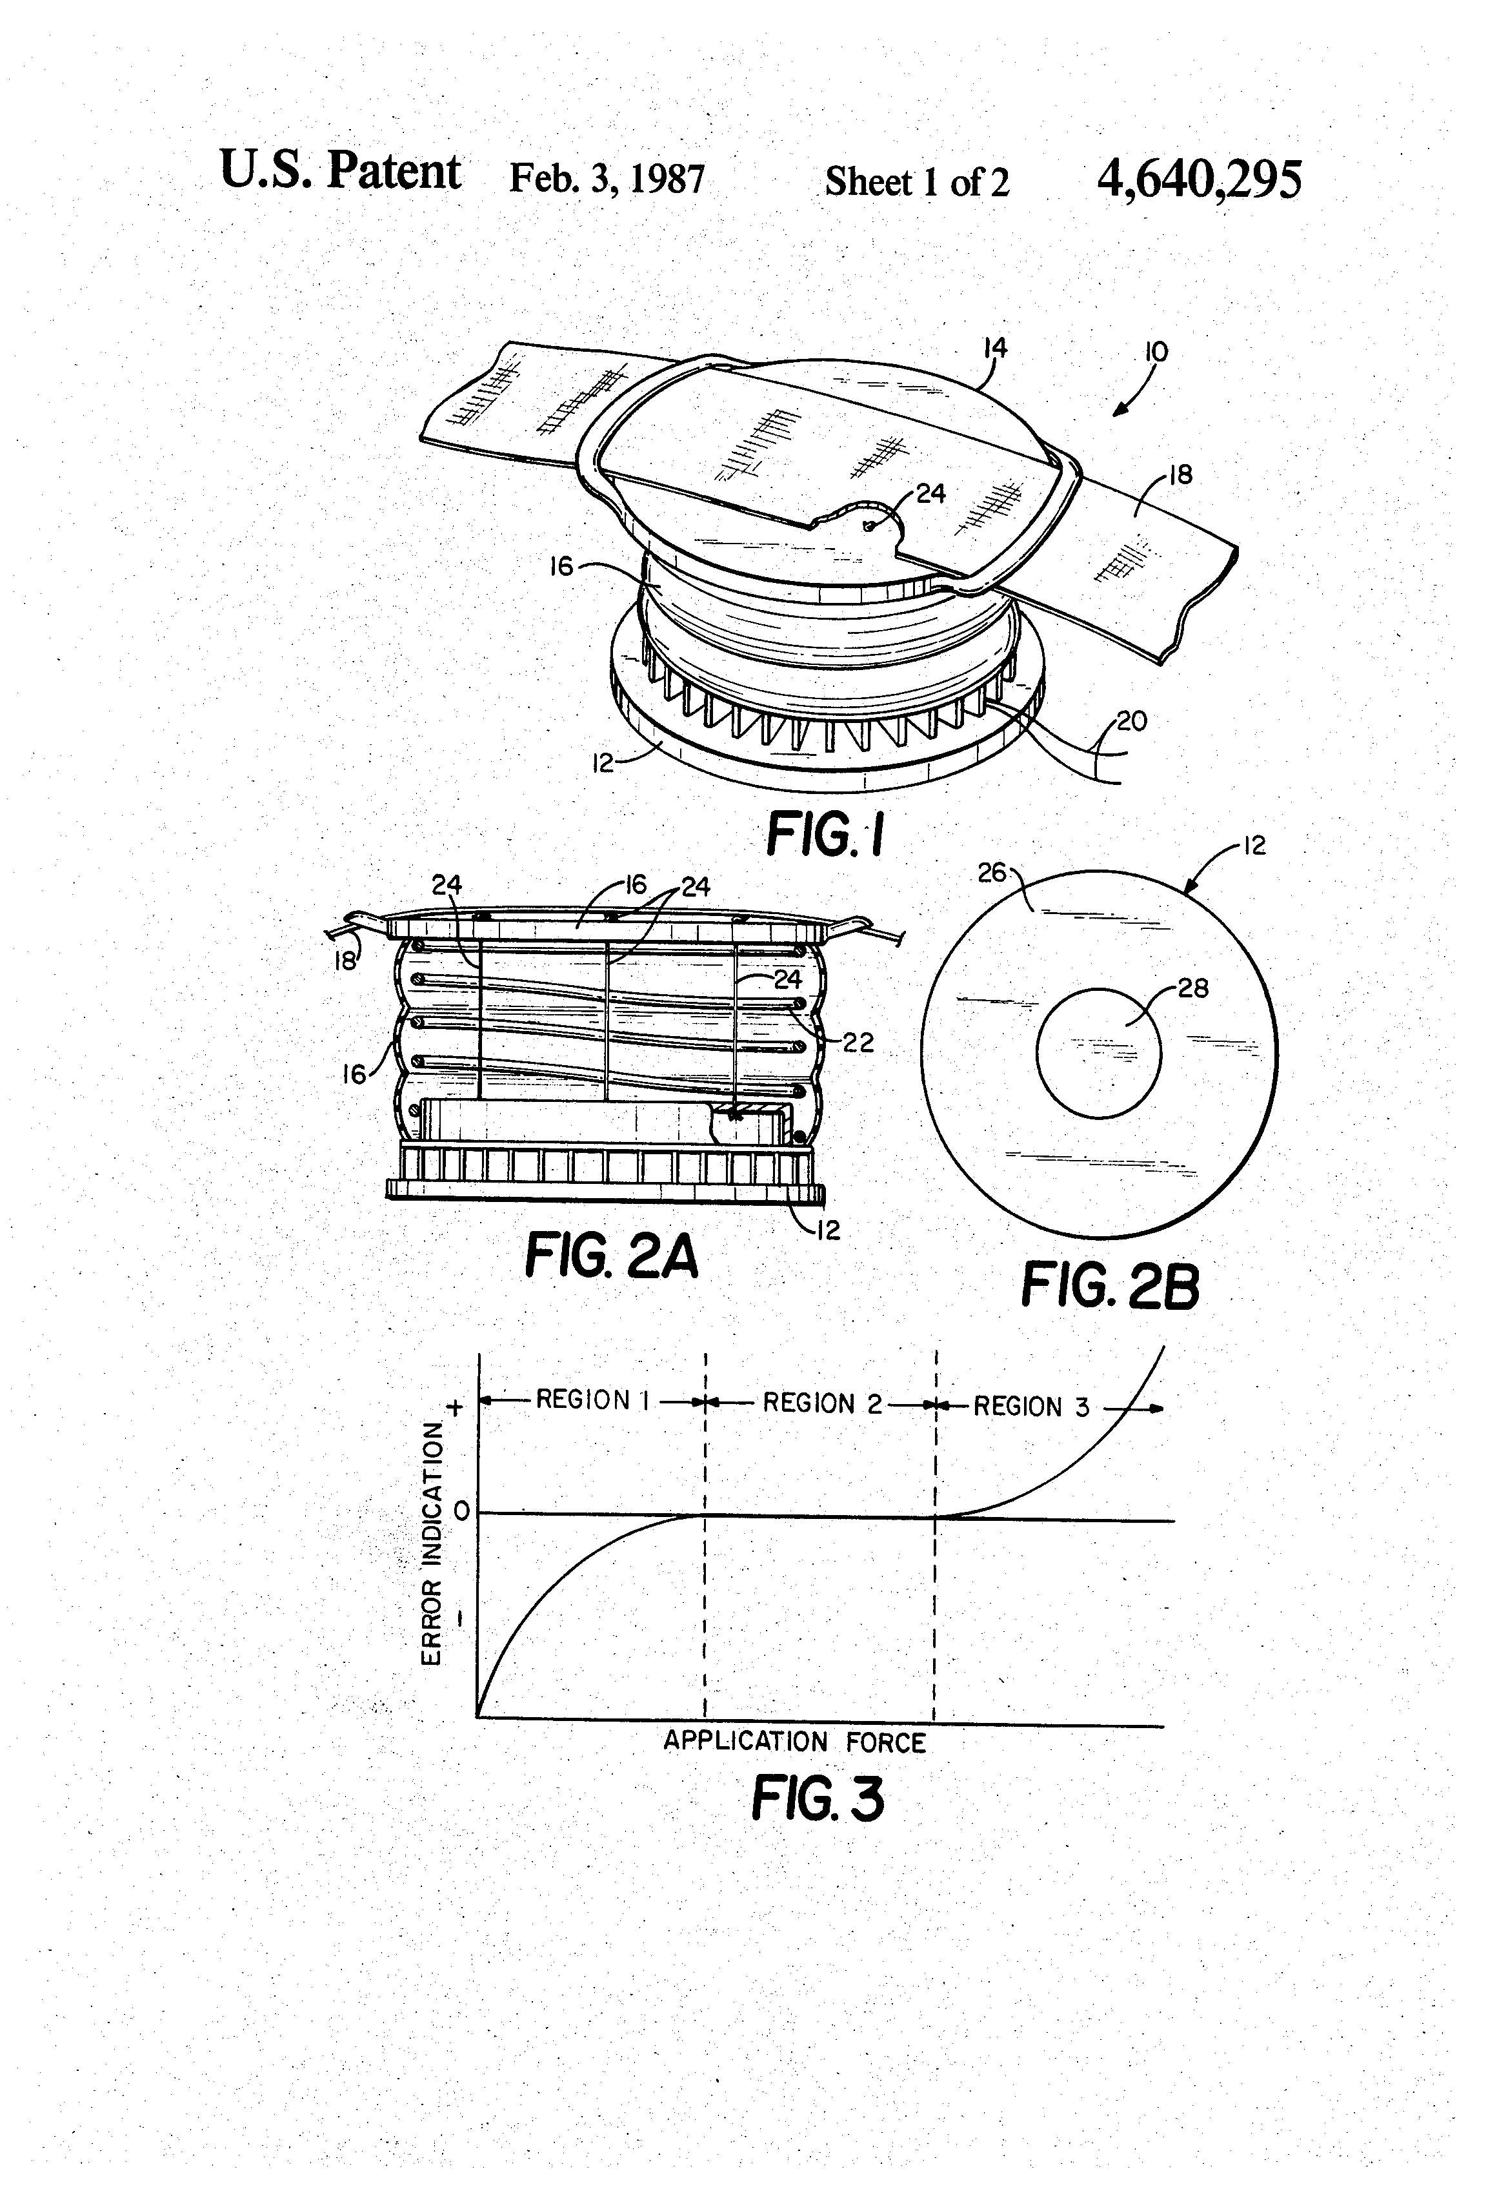
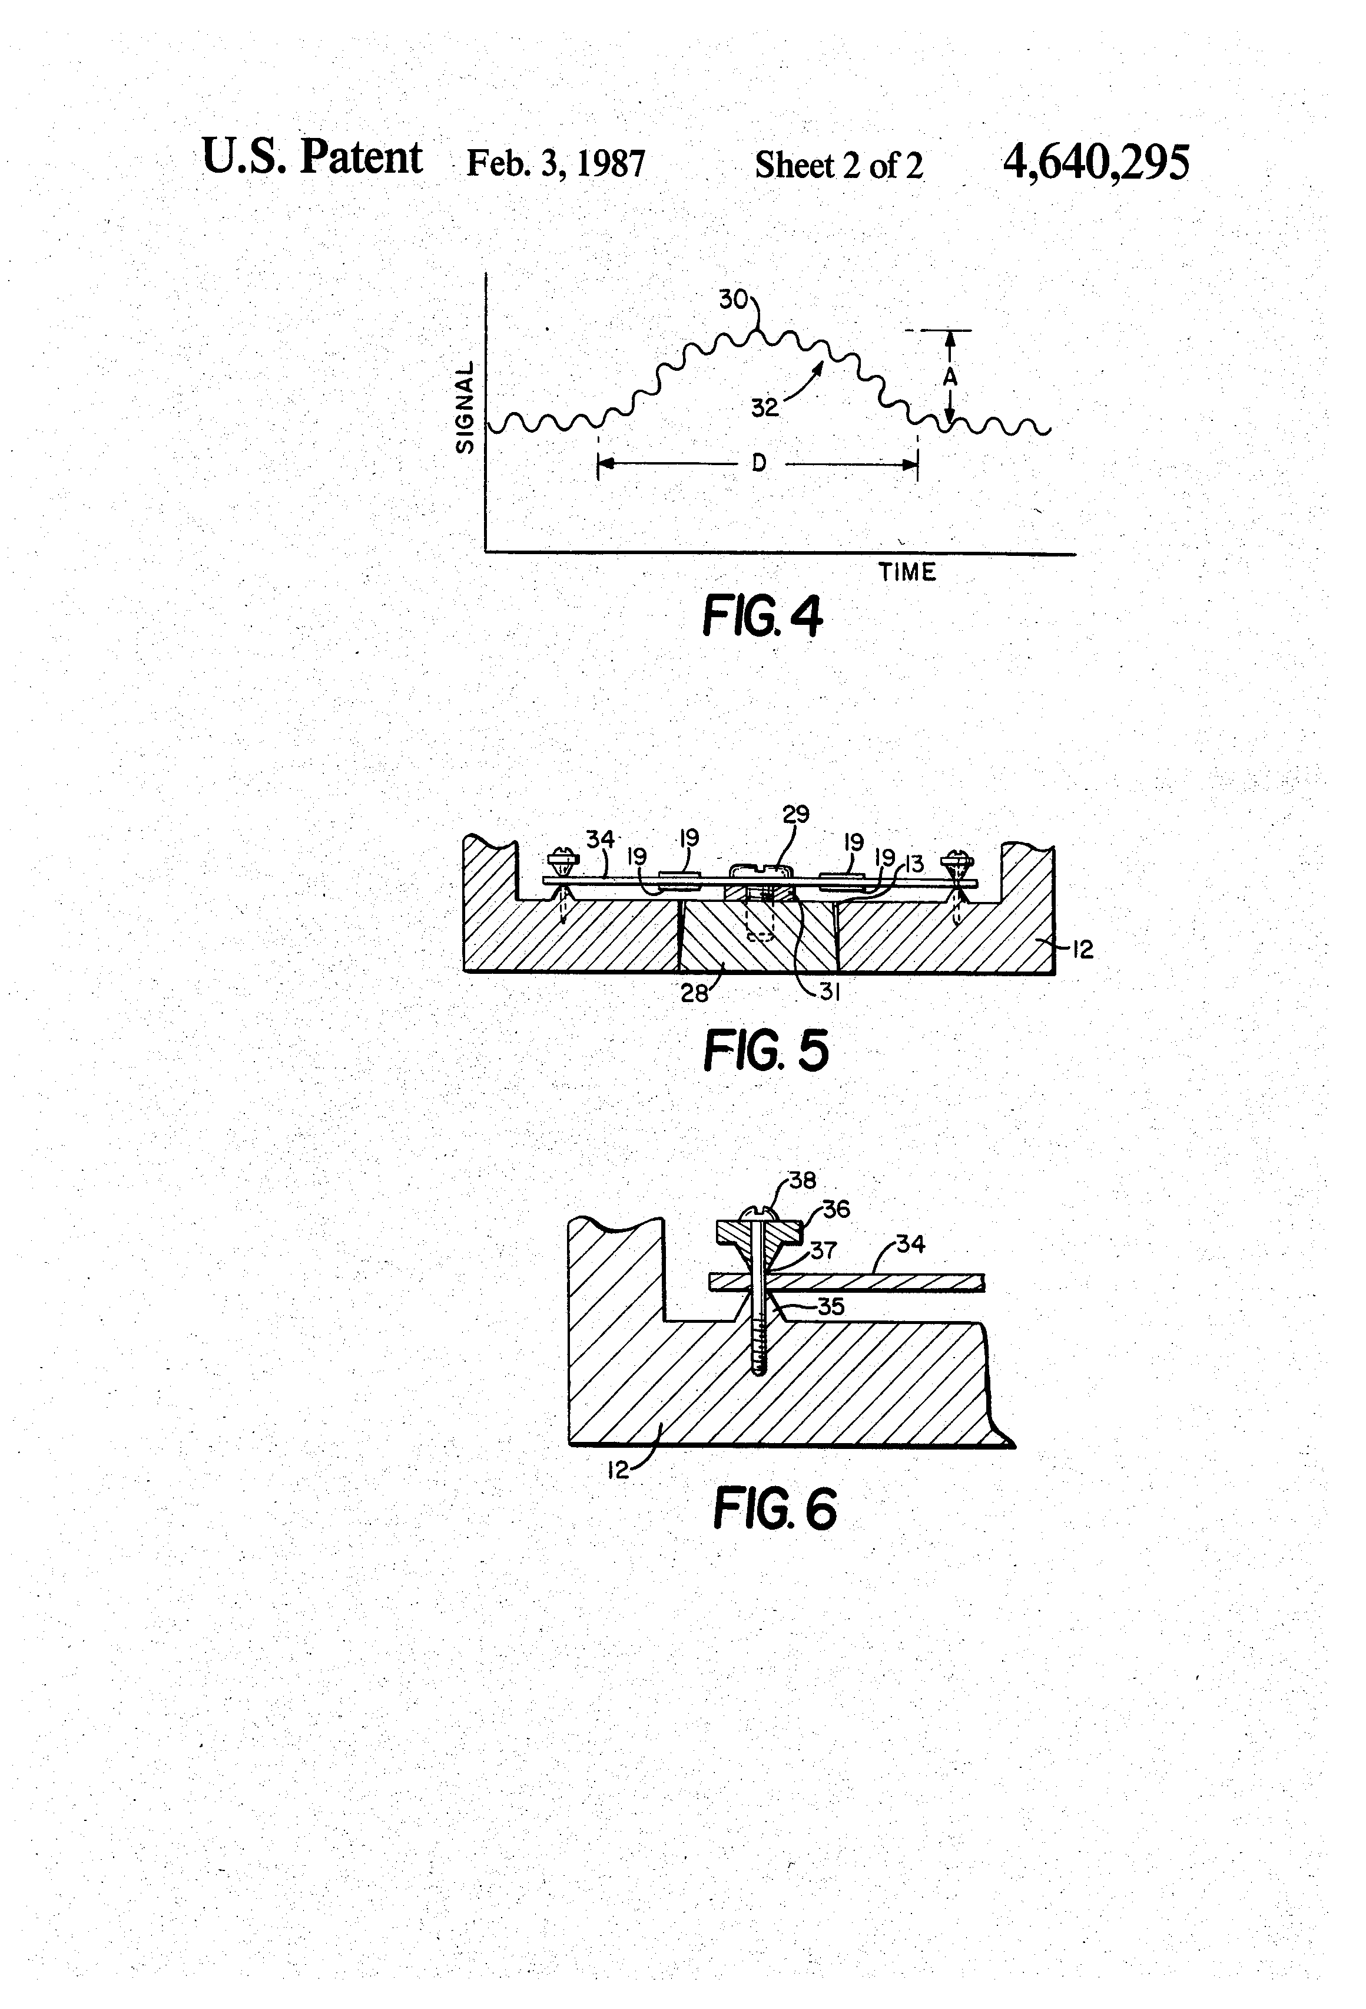
United States Patent
Electrohysterogram & Tocography (3/3)
Tocodynamometer device structure
Biomedical Engineering at Chung Yuan Christian University | Engineering World Health

Slide 24
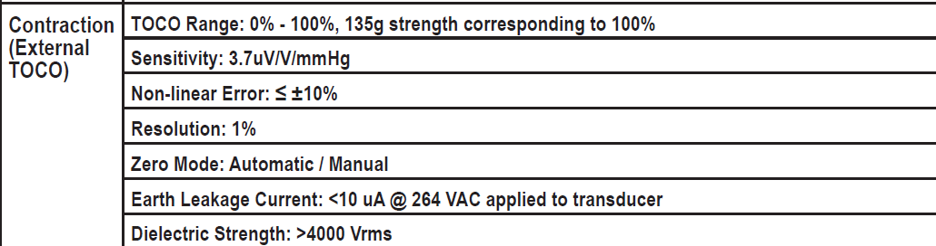
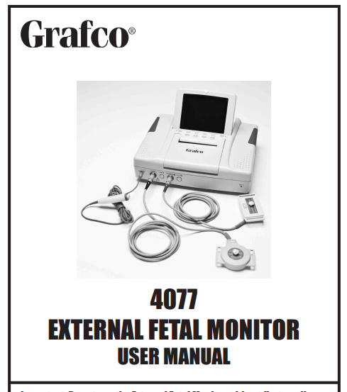
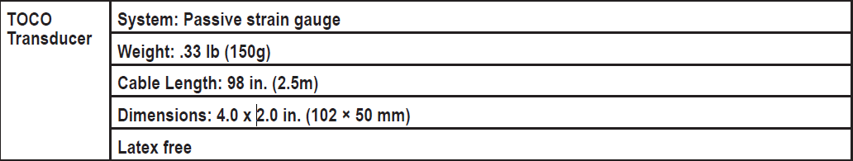
Commercial Available Product #1
Grafco - Specification

Slide 25
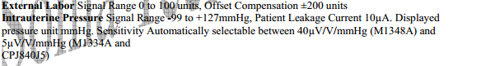
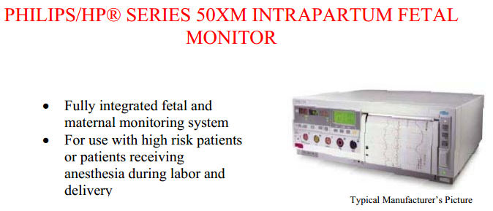
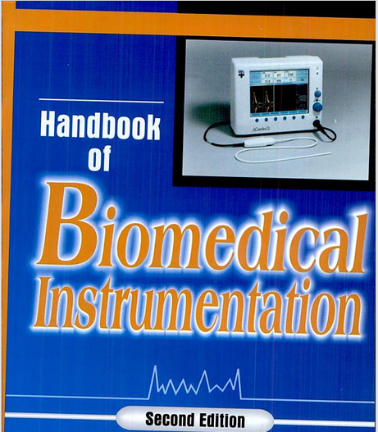
Commercial Available Product #2
Philips/HP - Specification

Slide 26
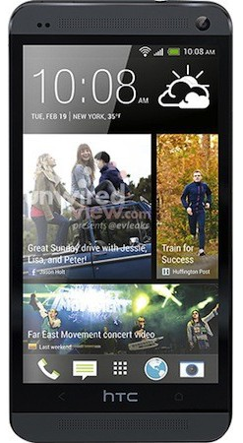

Our Approach for Smart-Phone Based Toco
Quality
Dependability
Durability

Slide 27
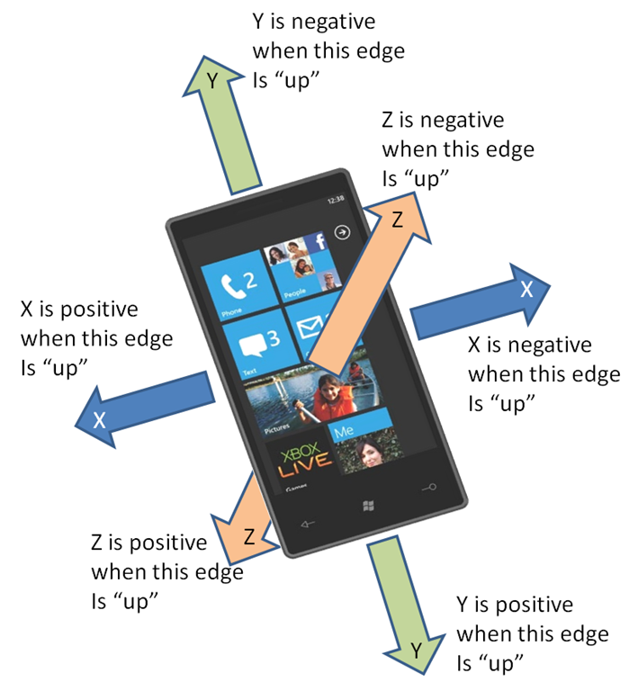
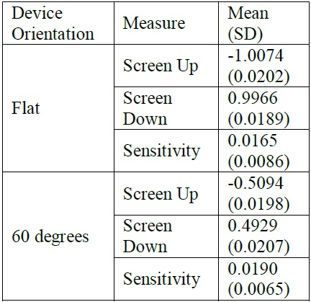
Goals & Target towards the Project (2/2)
Smart Phone Accelerometer
Reference: Department of Industrial and Manufacturing Engineering, et al, 2013, Sensitivity of Tri-Axial Device
Three Dimensional Axis (Tri-Axial)
Mean (SD) accelerations and sensitivity
1
2
Biomedical Engineering at Chung Yuan Christian University | Engineering World Health

Slide 28
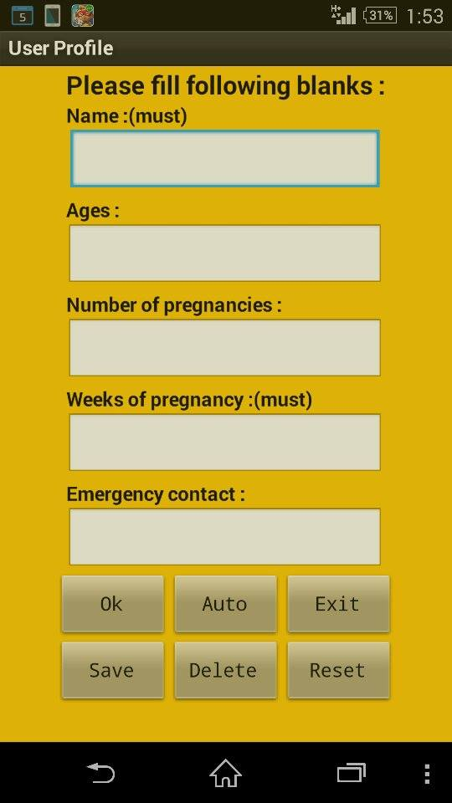

Button Function
Ok：Apply
Auto：Resume Saved user
Exit：Close the application
Save：Save user
Delete : Delete saved user
Reset：1.Delete all blanks by one click. 2.Delete all saved user by long click.
Name + Number of pregnancies
Page of User Profile

Slide 29
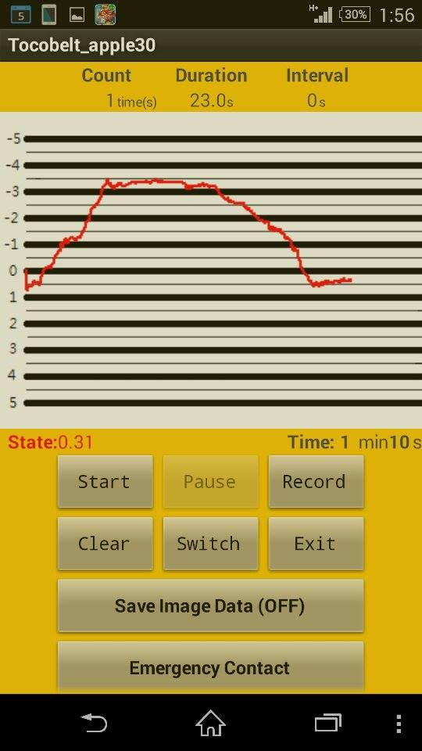
Main Page
Condition of Uterine contraction
Turn to records page
Start recording
Close the application
Clear all data by long click
Change user

Slide 30
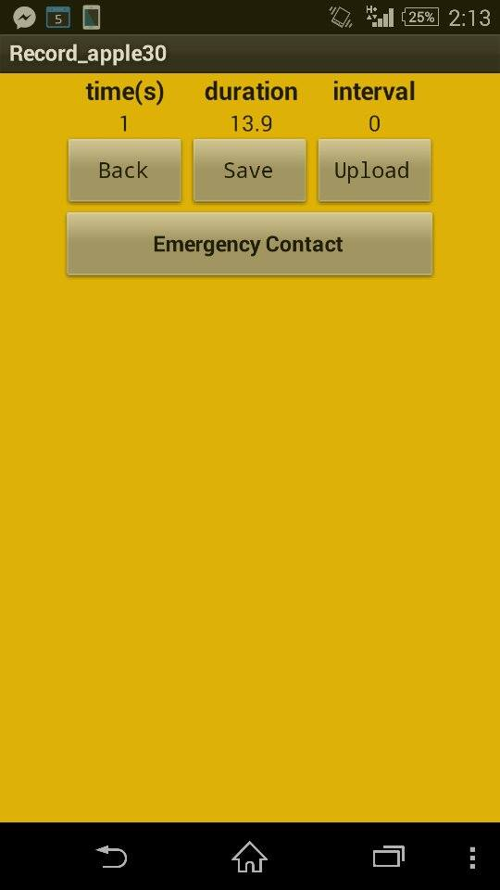
Data page
Upload to Cloud
Save to smartphone’s data base
Auto contact with the emergency contact person you have set previously

Slide 31

Difficulty & Solutions
Until Midterm Presentation
Calibration Process (No source of Phantom)

Slide 32
Solutions
Borrow Commercial Device from Equipment Supplier
Collaborate with OB/GYN Clinic
Construct a Force Pressure Sensing Device and Follow the spec on clinical Contraction threshold
P.A
P.B
P.C
Biomedical Engineering at Chung Yuan Christian University | Engineering World Health

Slide 33

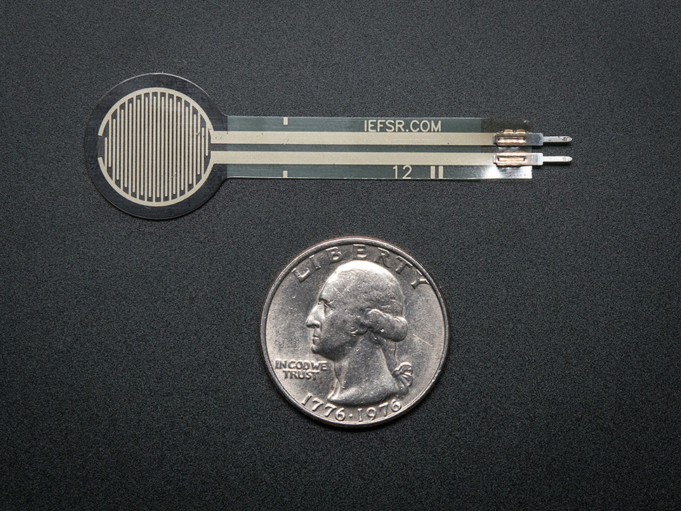

Plan C (1/2)
Biomedical Engineering at Chung Yuan Christian University | Engineering World Health

Slide 34
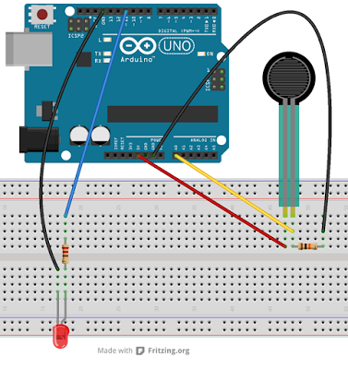
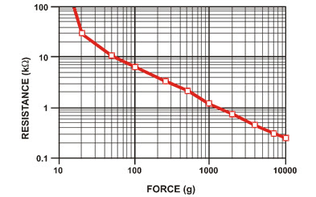
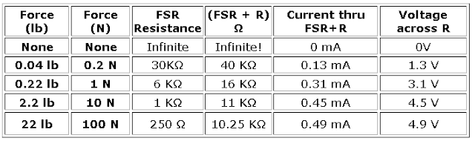
Plan C (2/2) . Apply on Arduino
Biomedical Engineering at Chung Yuan Christian University | Engineering World Health

Slide 35
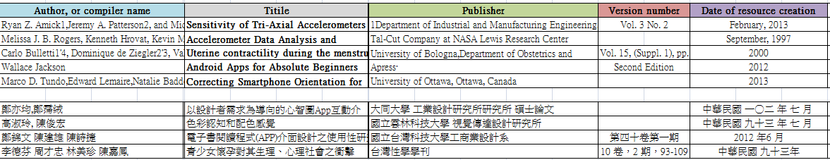
Source of Reference
Last Updated on: Jan 5th, 2015

Slide 36

THANK YOU

